Slide 1
Transformer
Language Models

Slide 2
Course Contents
Deep Learning
Transformer
Finetuning
Agents
The Bigger Picture
Context Engineering
Instruction Tuning
LLMs

Slide 3
This Part: Transformer
tokenizer
static embeddings
contextual embeddings
text generation

Slide 4
Tokenization
tokenization: breaking text in chunks
word tokens: different forms, spellings, etc → undefined and vast vocabulary
character tokens: not enough semantic content (longer sequences)
popular compromise: byte-pair encoding

Slide 5
Byte-Pair Encoding
data compression method used for encoding text as sequence of tokens (sub-words)
merging token pairs (starting with characters) with maximum frequency
continue merging until defined fixed vocabulary size (hyperparameter) is reached
common words encoded as single token
rare words encoded as sequence of tokens (representing word parts)
alternative: direct operation on bytes (e.g., ByT5)
aaabdaaabac
ZabdZabac
Z=aa
ZYdZYac
Y=ab
Z=aa
XdXac
X=ZY
Y=ab
Z=aa
example from wikipedia

Slide 6
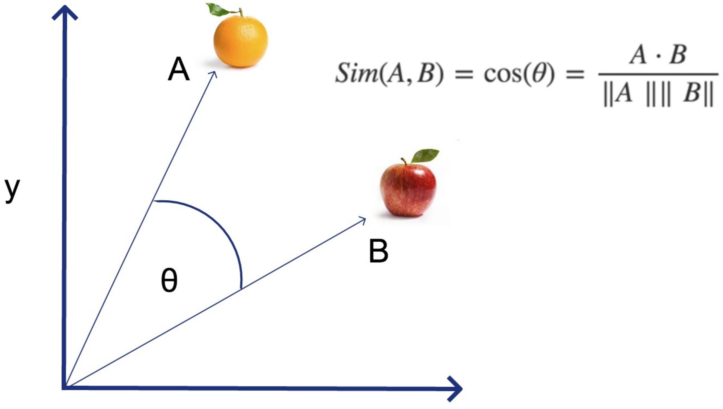
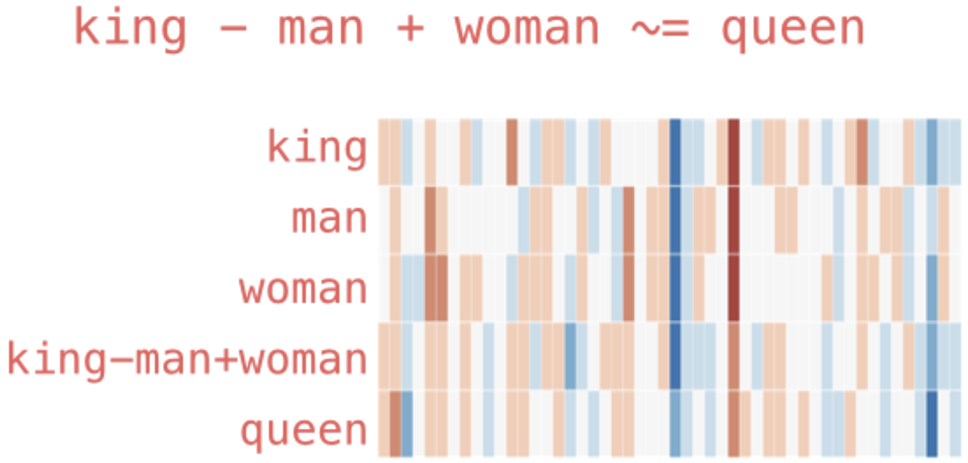
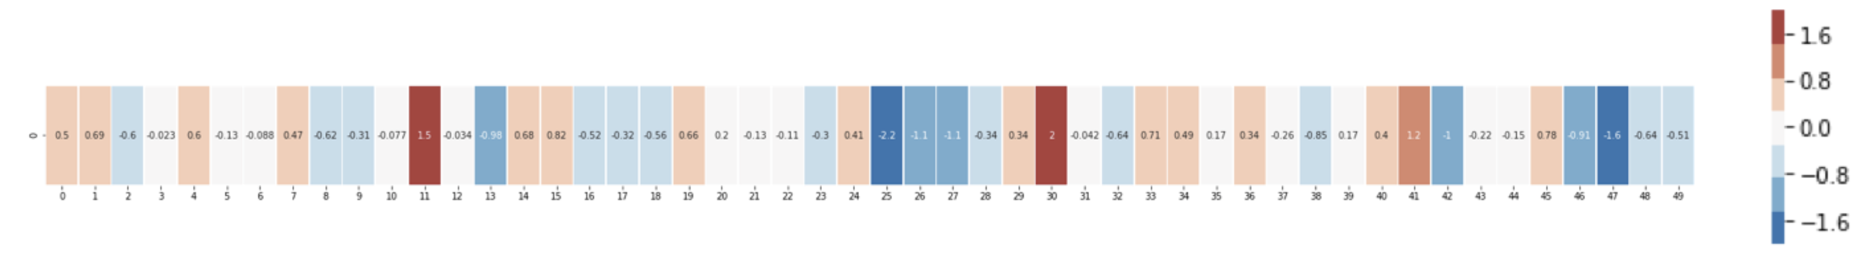
Embedding Layers
representation of entities by vectors
→ semantic similarity
most famous application: word embeddings
→ associations (natural language processing)
but general concept: embeddings of (categorical) features (e.g., products in recommendation engines)
learned via co-occurrence (e.g., word2vec)
but also direction of difference vectors interesting (analogies):
source

Slide 7
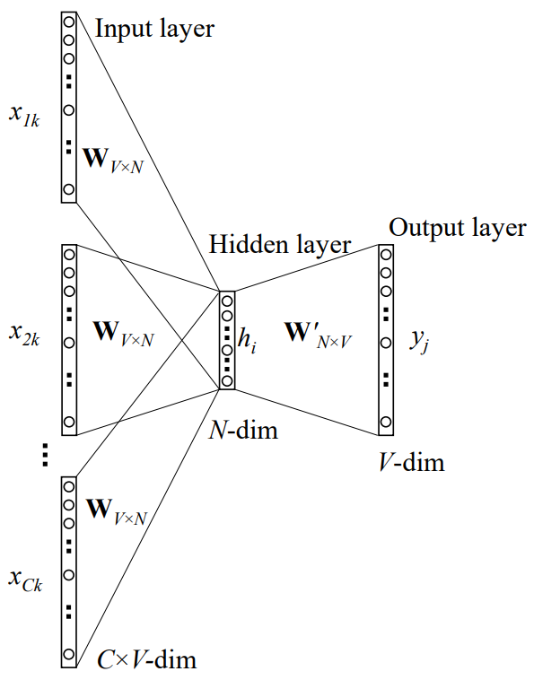
Some Thoughts on Word Embeddings
can be implemented as
neural network with single hidden layer (linear activation)
using, e.g., bag-of-words approach (predict masked word from its surroundings)
not context-aware
CBOW:
source
softmax of target word
word vector (embedding) by multiplication with one-hot vector
one-hot vectors of context words

Slide 8
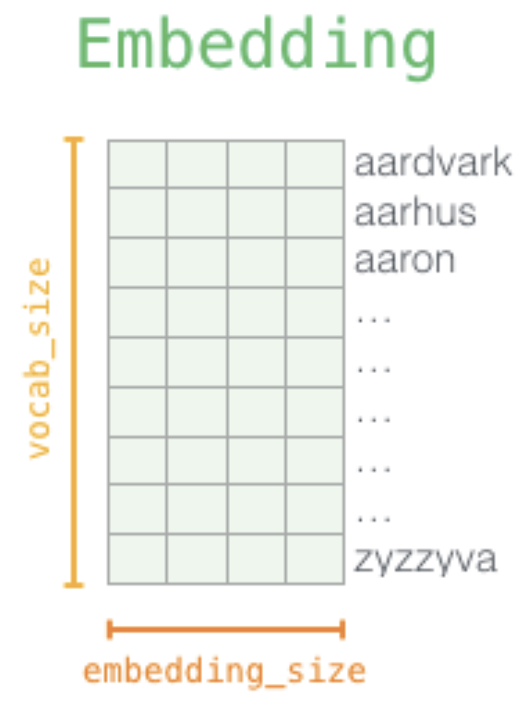
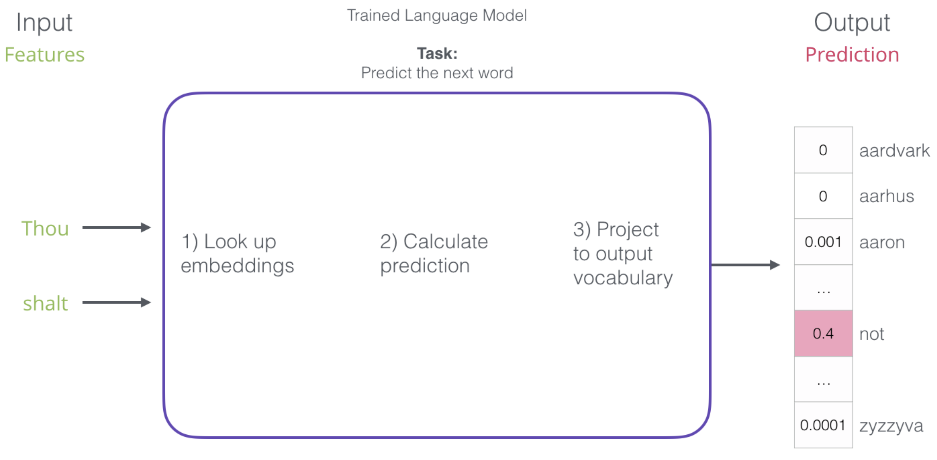
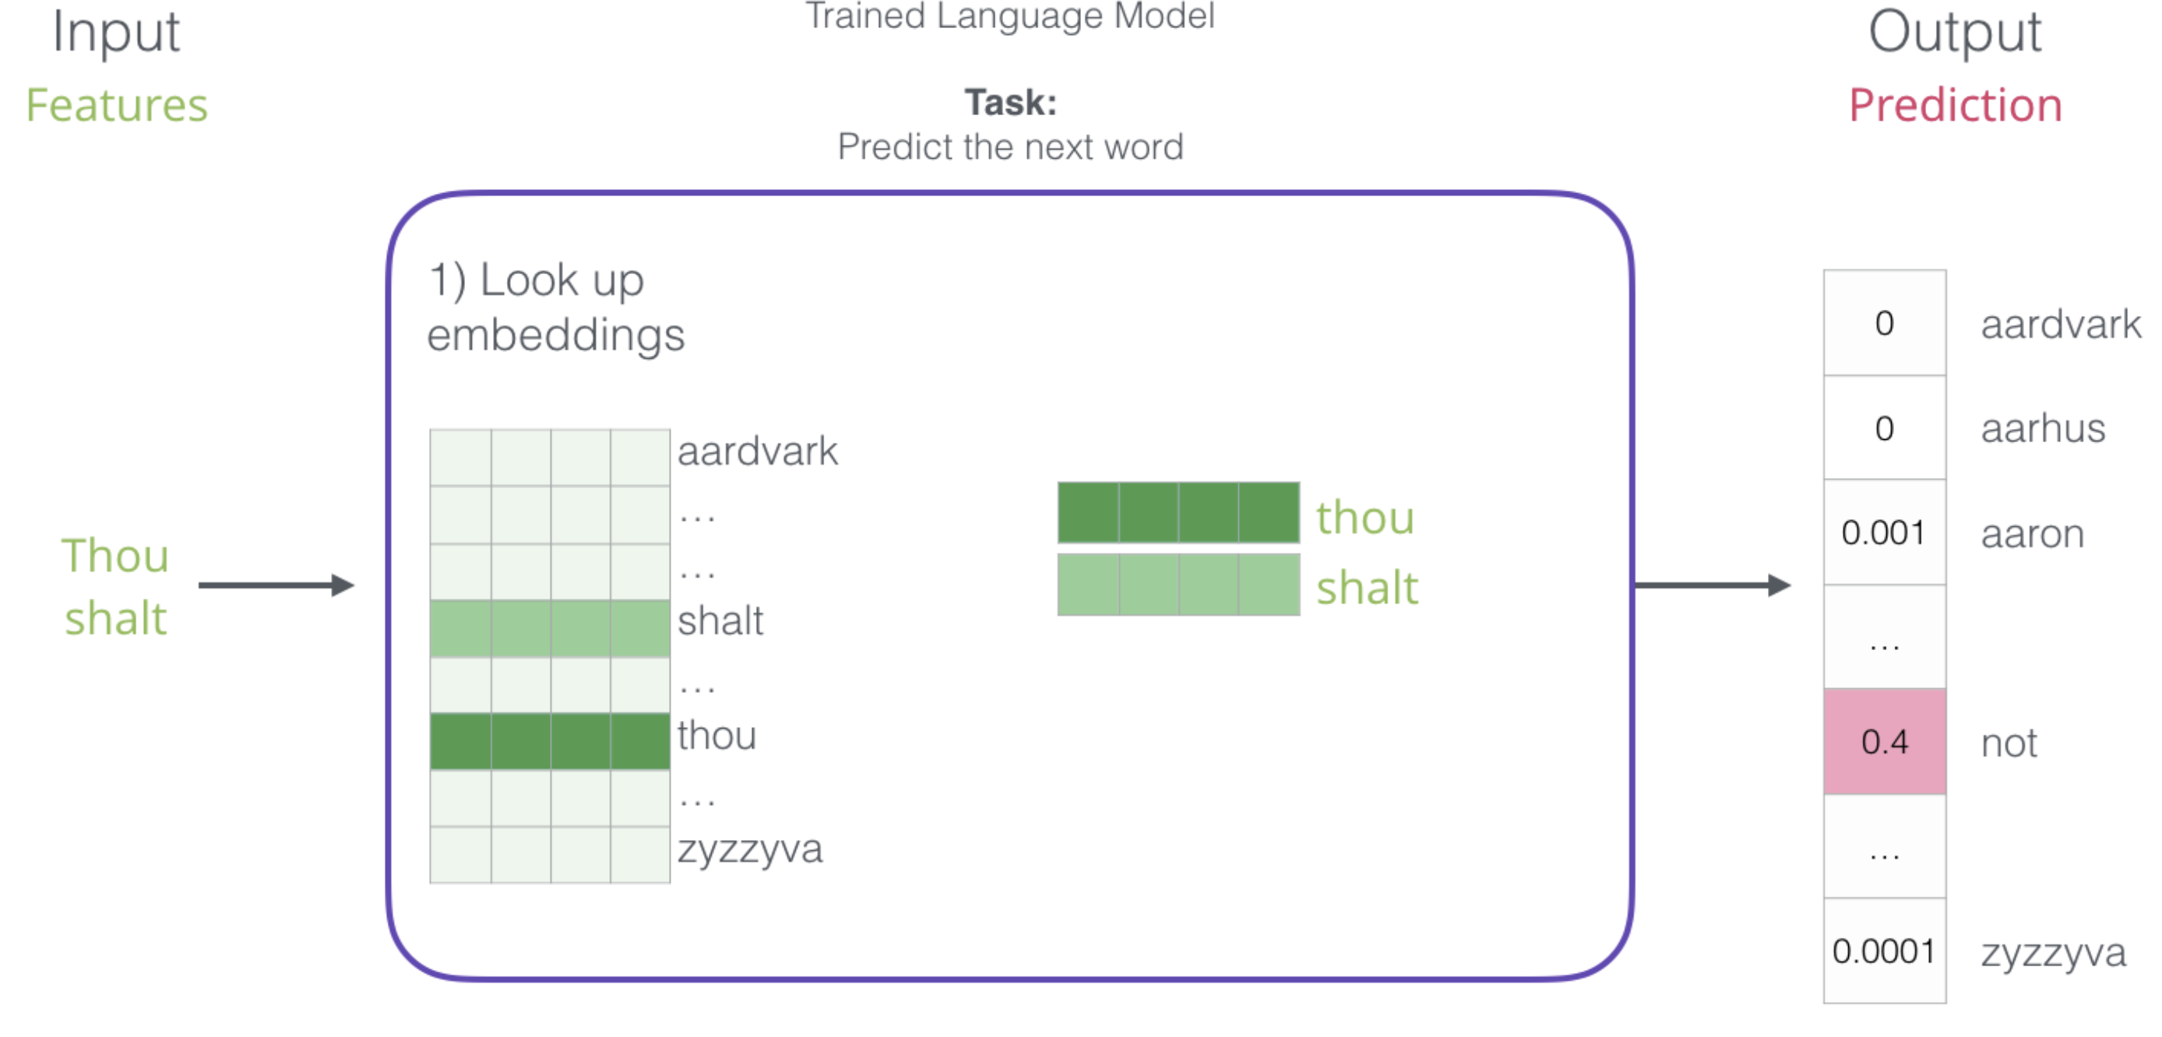
Word Embeddings as Part of Language Model
language models contain embedding matrix as part of learned parameters
typically several hundred dimensions for word vectors (to be compared with vocabulary sizes of many thousands)
(can also be extracted and subsequently used as pretrained embeddings for other task)
next-word prediction:
source

Slide 9
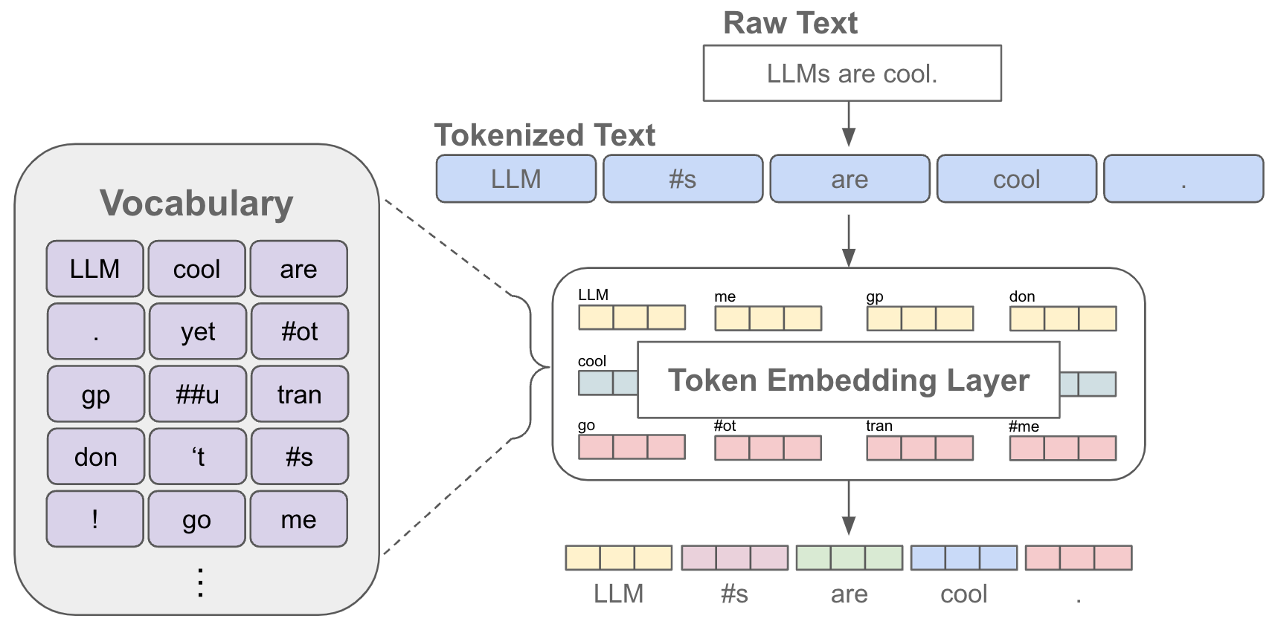
Tokenization & Embeddings
source

Slide 10
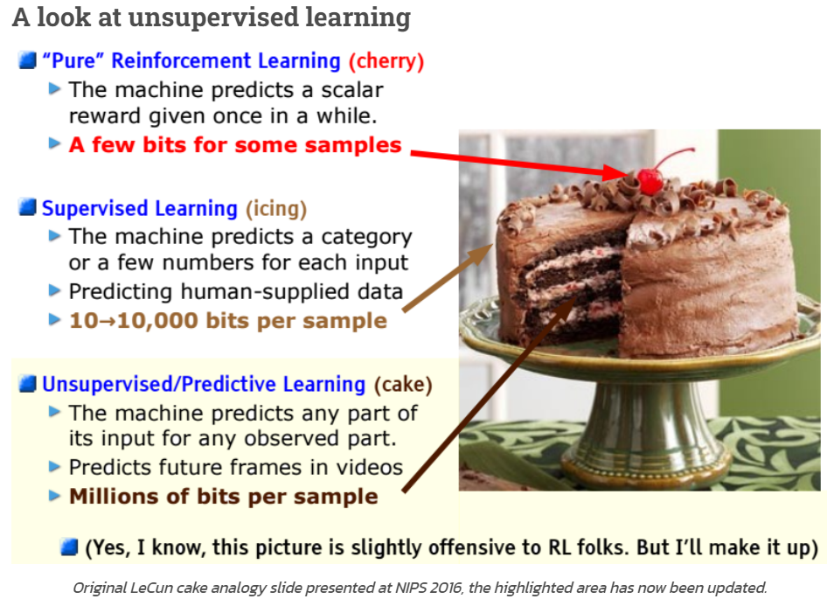
Self-Supervised Learning
ML needs lots of training data
unsupervised learning (learning by observation)
no target information → kind of “vague” pattern recognition (but plenty of data)
can be cast as self-supervised learning:
input-output mapping like supervised learning
but generating labels itself from inputs
source
The Lord of the Rings is considered one of the greatest fantasy
The Lord of the Rings is considered one of the greatest fantasy books

Slide 11

Context Awareness: Transformer
original transformer: sequence-to-sequence model (e.g., for machine translation)
Attention Is All You Need:
completely replaced recurrent neural networks (RNN)
much more parallelization → bigger models
better long-range dependencies thanks to shorter path lengths in network (less sequential operations)
encoder/decoder stacks (depth): output fed as input to next one
encoder
decoder

Slide 12
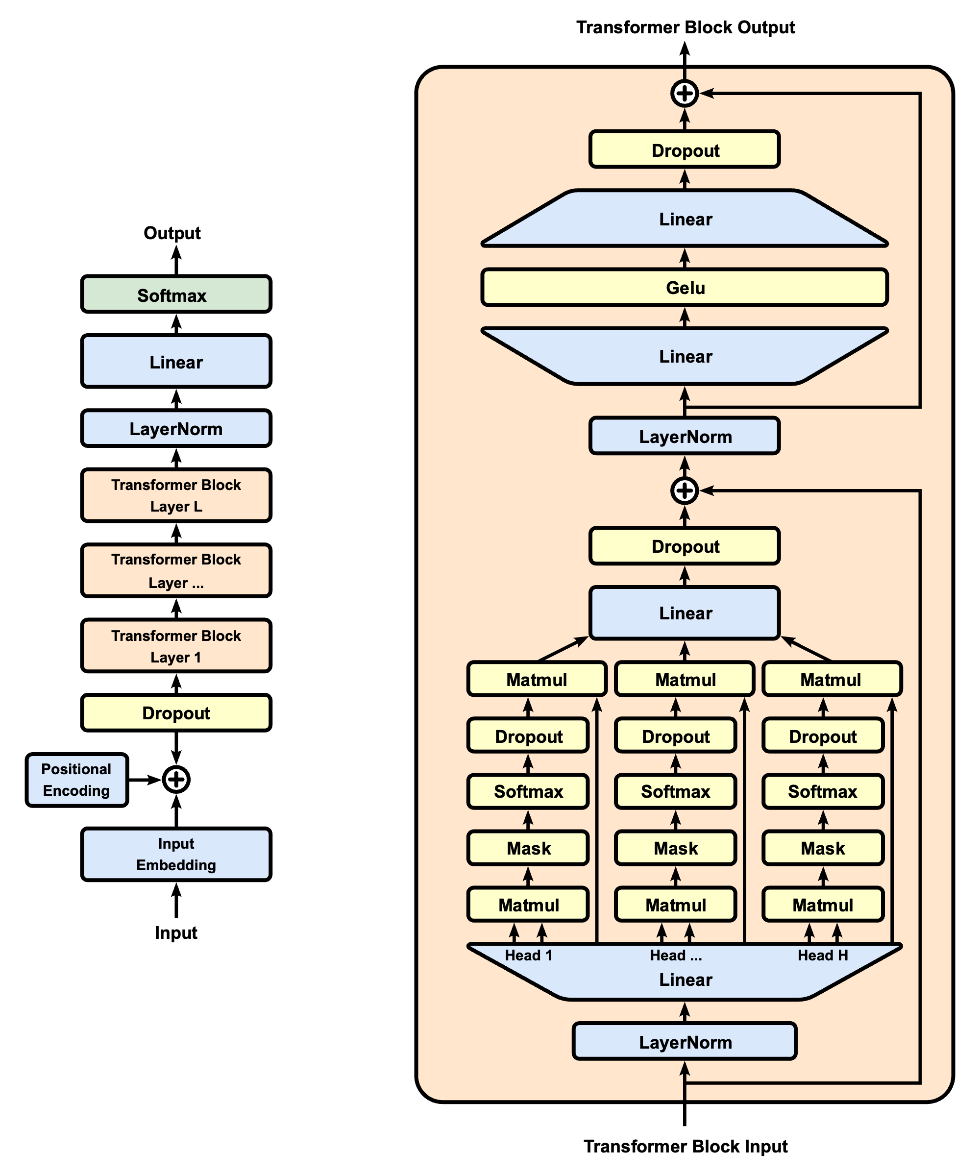
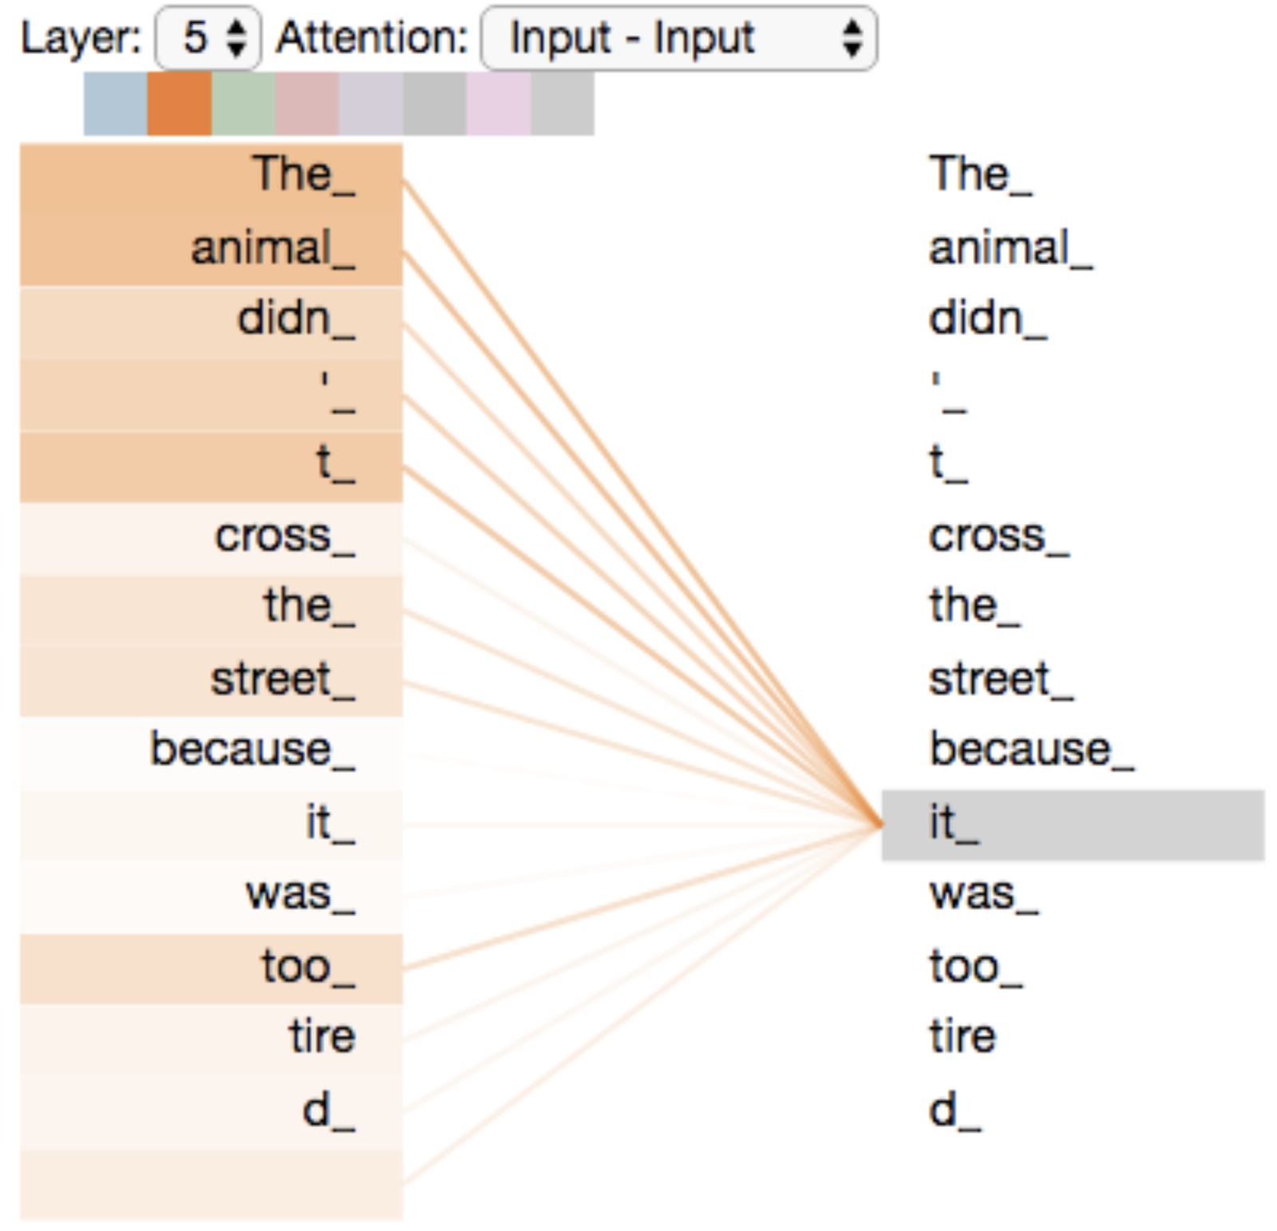
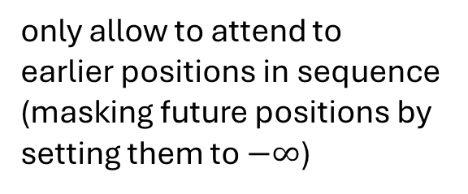
Self-Attention Mechanism
GPT (decoder-only):
evaluating other input tokens in terms of relevance for encoding of given token
computational complexity quadratic in length of input (each token attends to each other token)
only allow to attend to earlier positions in sequence (masking future positions by setting them to $−∞$)
source

Slide 13
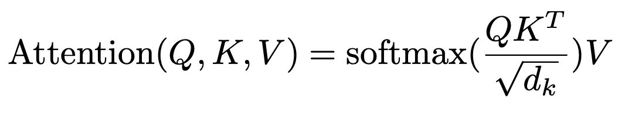

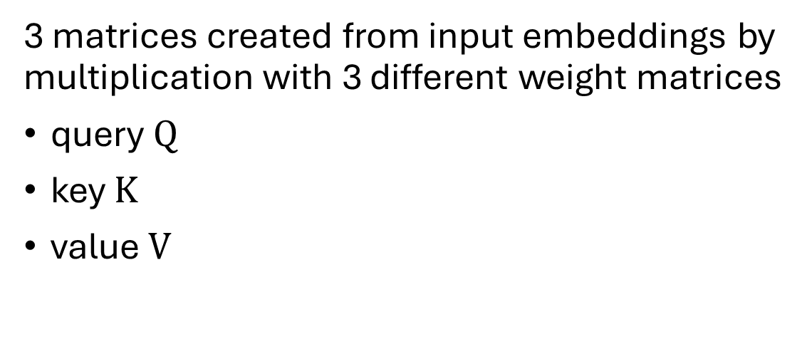
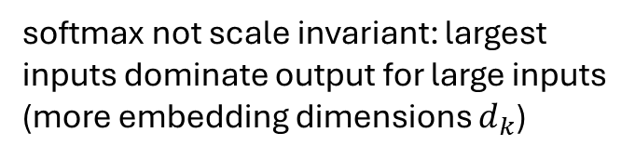
Scaled Dot-Product Attention
softmax not scale invariant: largest inputs dominate output for large inputs (more embedding dimensions $d_{k}$)
3 matrices created from input embeddings by multiplication with 3 different weight matrices
query $Q$
key $K$
value $V$
filtering: multiplication of attention probabilities with corresponding key-word values
scoring each of the key words (context) with respect to current query word: multiplication of inputs (in contrast to inputs times weights in neural networks)
key-value pairs
query
source

Slide 14
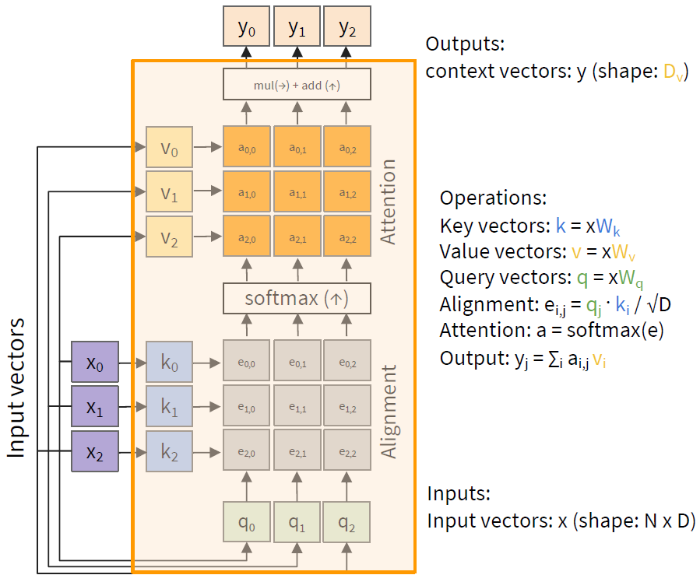
MatMul
weighted average: reflecting to what degree a token is paying attention to the other tokens in the sequence

Slide 15
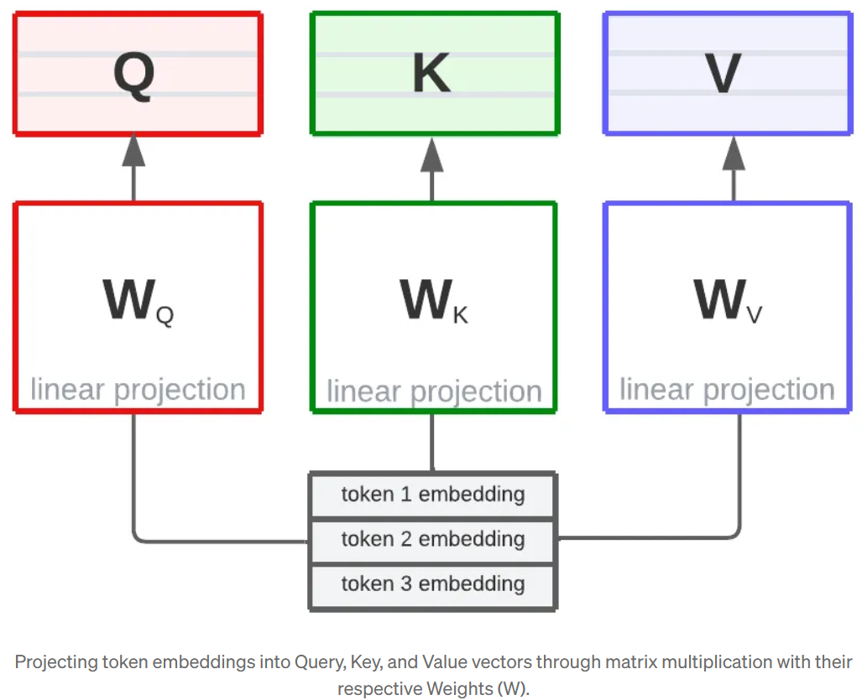
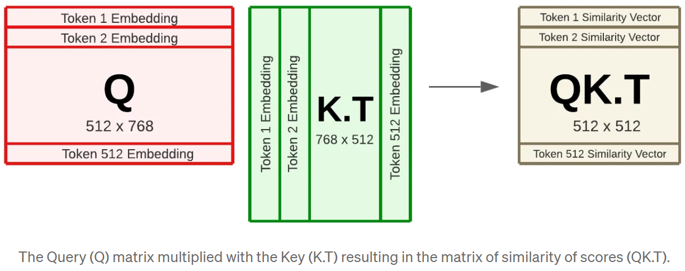
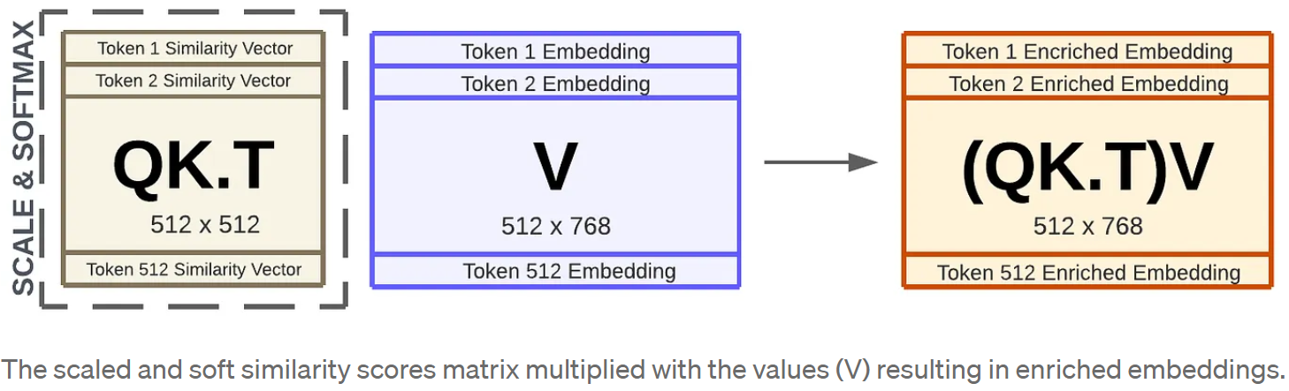
Example: Dimensions in BERT
2
1
3
source

Slide 16
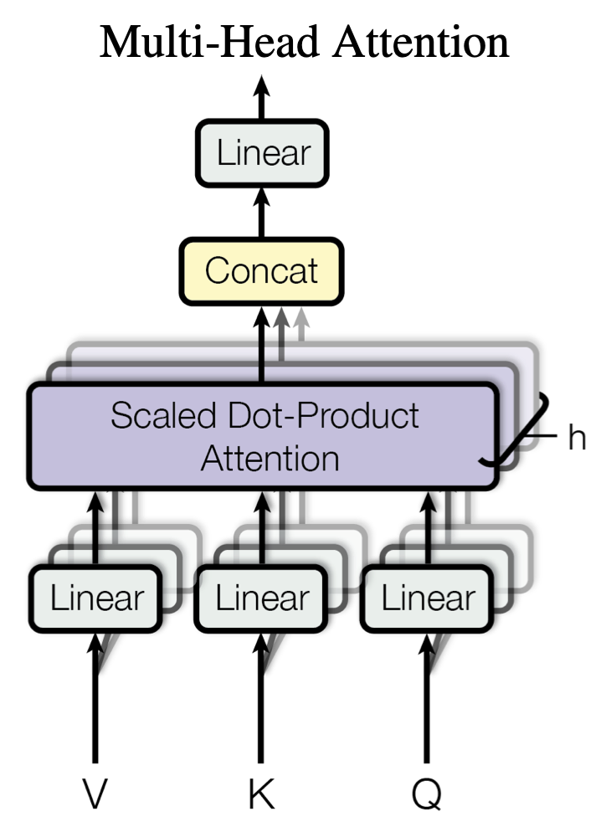

Multi-Head Attention
multiple heads: several attention layers running in parallel
different heads can pay attention to different aspects of input (multiple representation sub-spaces)
source
source

Slide 17
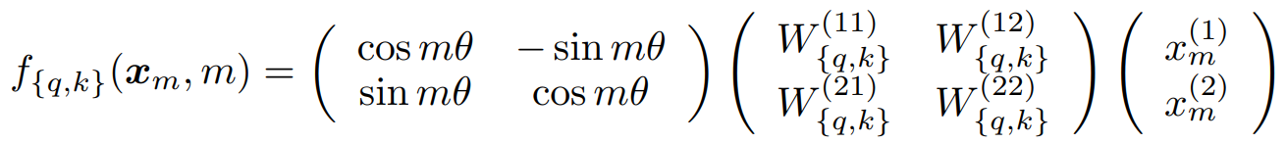
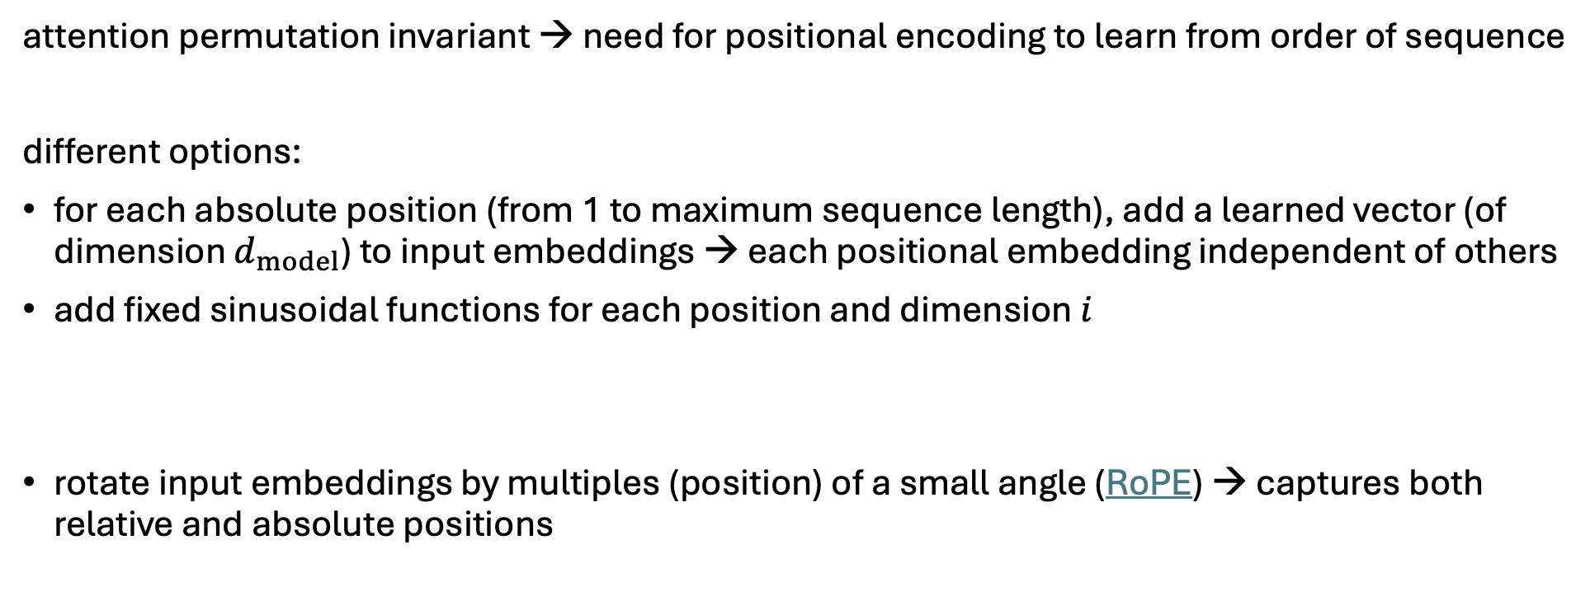
Positional Encoding
attention permutation invariant → need for positional encoding to learn from order of sequence
different options:
for each absolute position (from 1 to maximum sequence length), add a learned vector (of dimension $d_{model}$) to input embeddings → each positional embedding independent of others
add fixed sinusoidal functions for each position and dimension $i$
rotate input embeddings by multiples (position) of a small angle (RoPE) → captures both relative and absolute positions
$${PE}_{pos,2i}=\sin\left(\frac{pos}{{10000}^{\frac{2i}{d_{model}}}}\right) {PE}_{pos,2i+1}=\cos\left(\frac{pos}{{10000}^{\frac{2i}{d_{model}}}}\right)$$

Slide 18
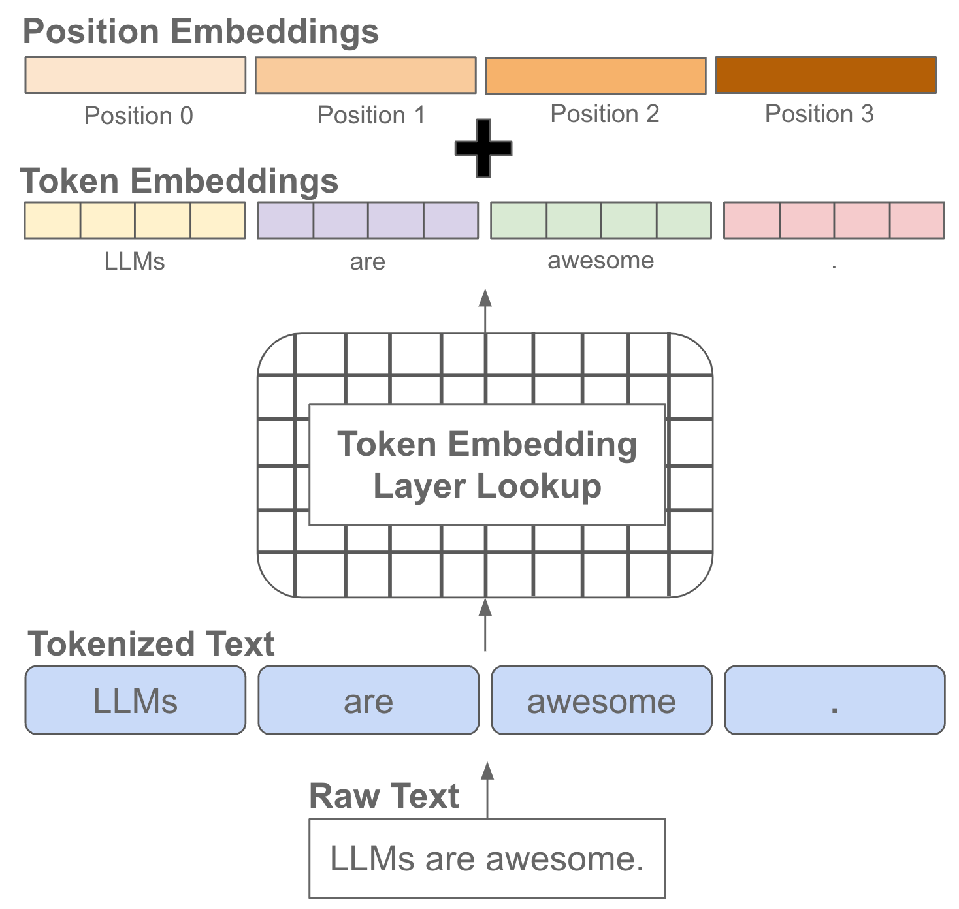
source

Slide 19
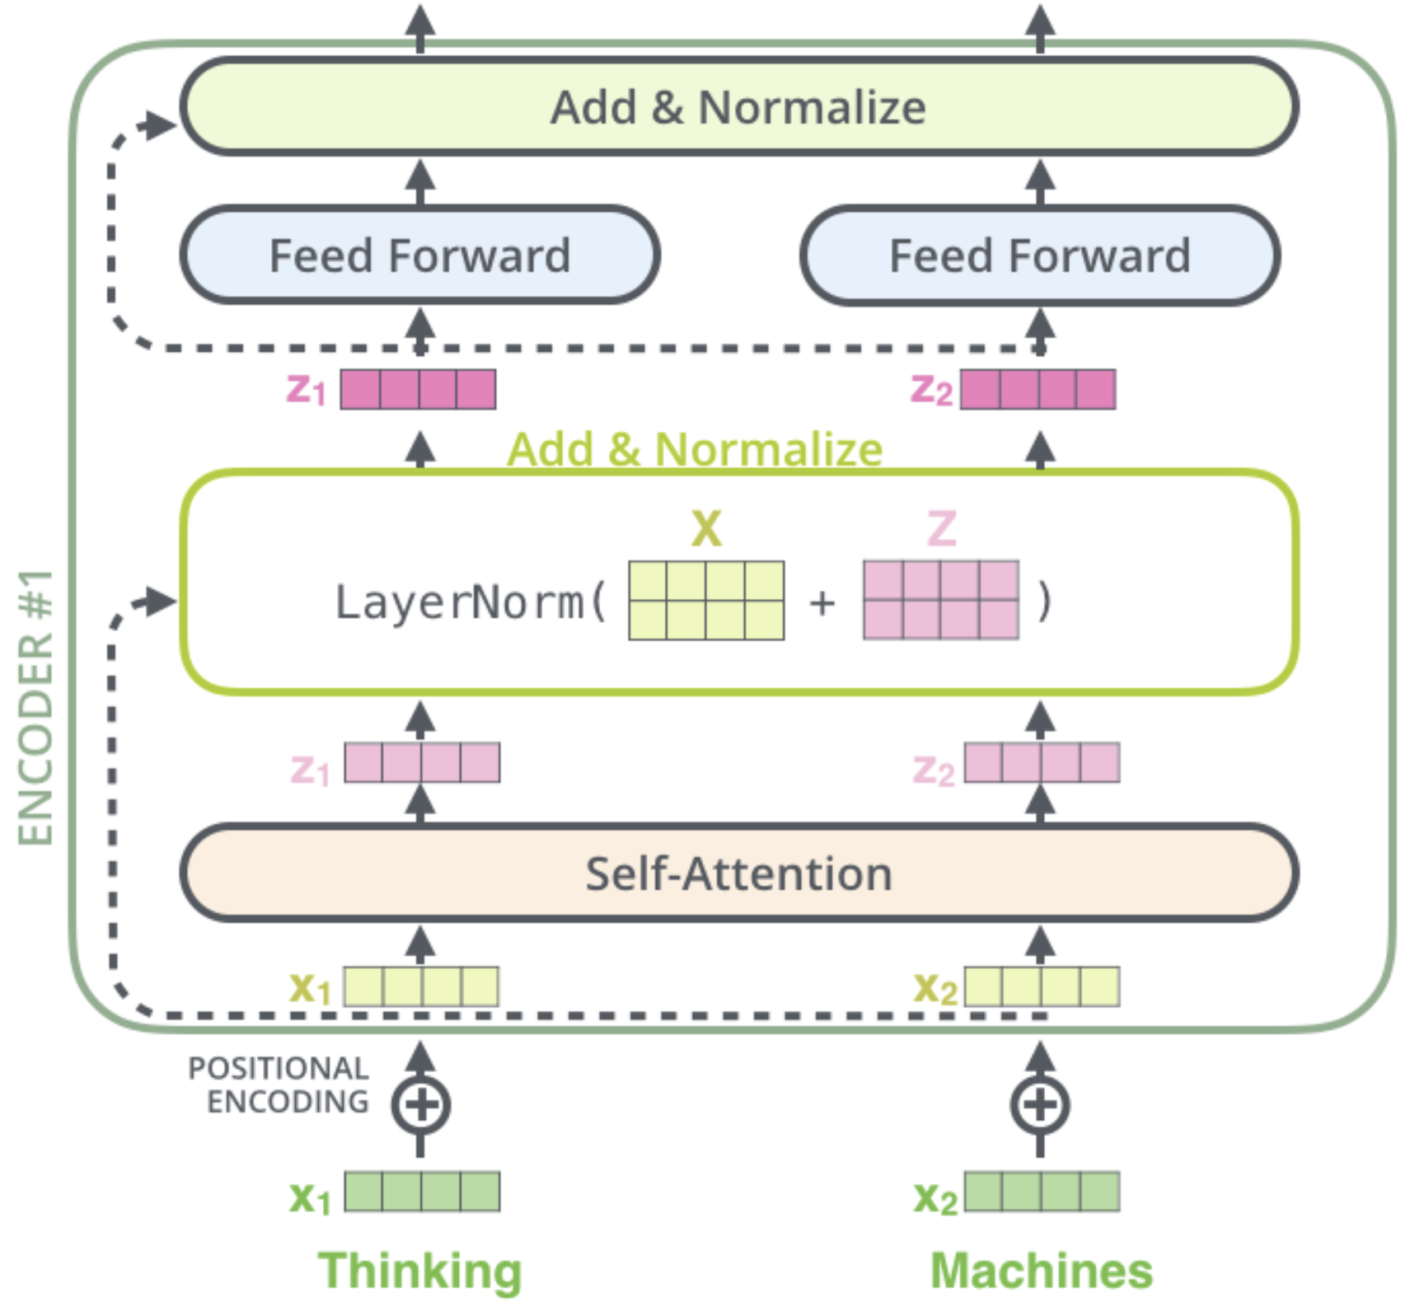
Skip Connections and Layer Normalization
skip connections improve robustness by
preserving original input (attention layers as filters) as well as gradients (mitigate vanishing-gradient problem)
easier learning of identity functions (useful for disregarding modules that do not improve model performance)
layer normalization improves stability, convergence, and generalization by normalizing activations per input token
source

Slide 20
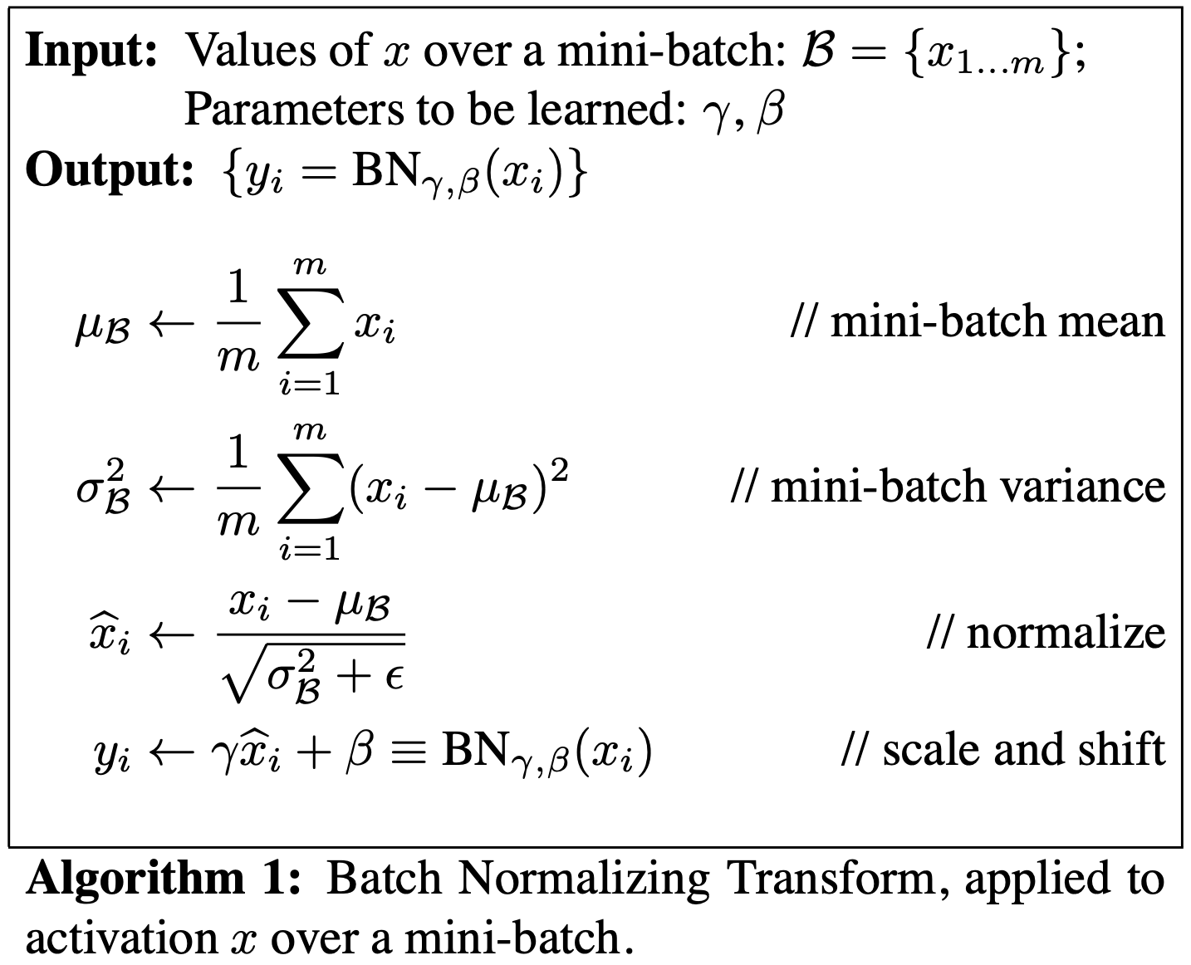
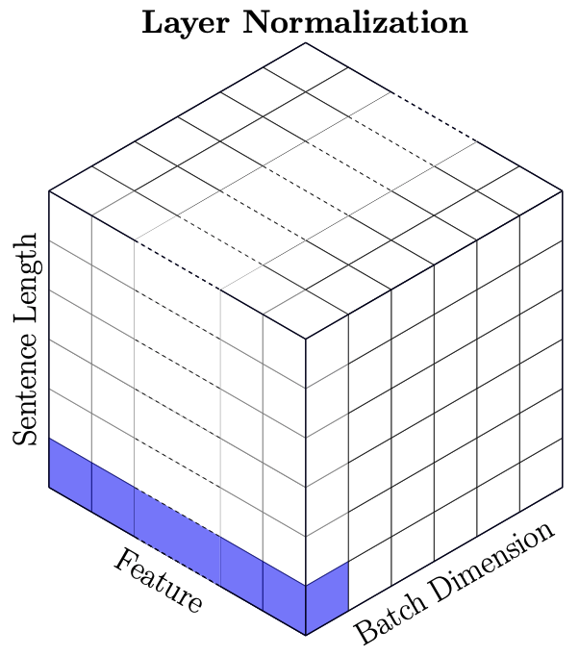
Batch vs Layer Norm
batch norm typically in computer vision
layer norm in NLP (variable-sized inputs)
source

Slide 21
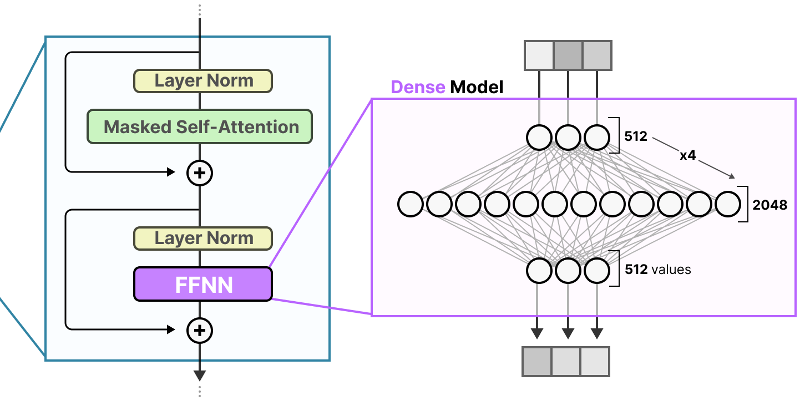
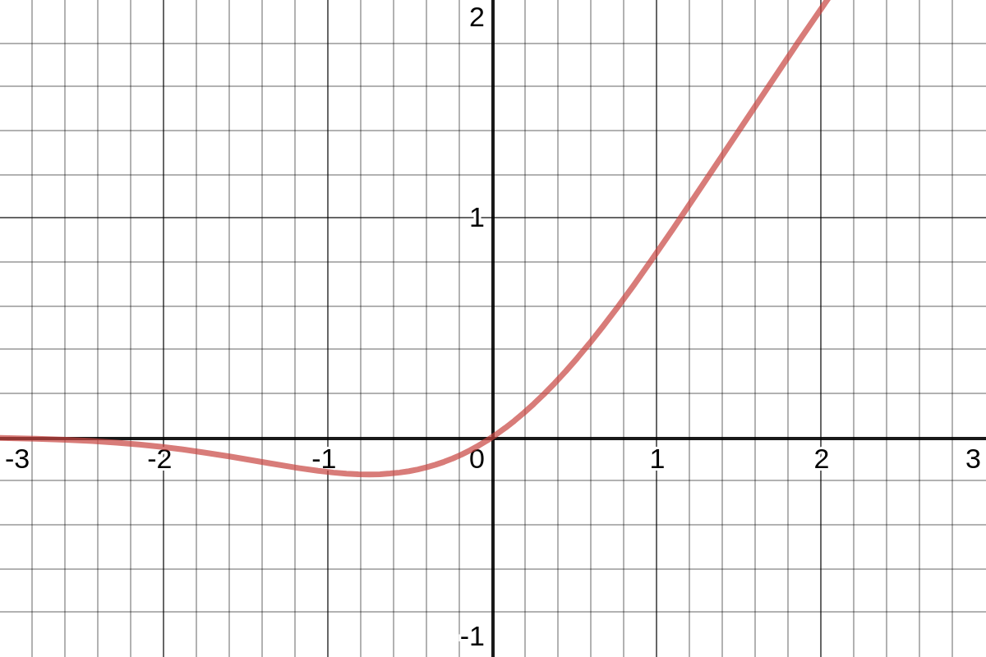
Role of Feed-Forward Neural Networks (FFNN)
position-wise FFNNs:
following each attention layer, apply an identical FFNN (with two layers) independently to each embedding vector
(correspond to bulk of overall parameters)
source
can be interpreted as compute after connect (attention)
attention is just weighted averaging
→ need for non-linearities (often GeLU activations) to capture more complex patterns

Slide 22
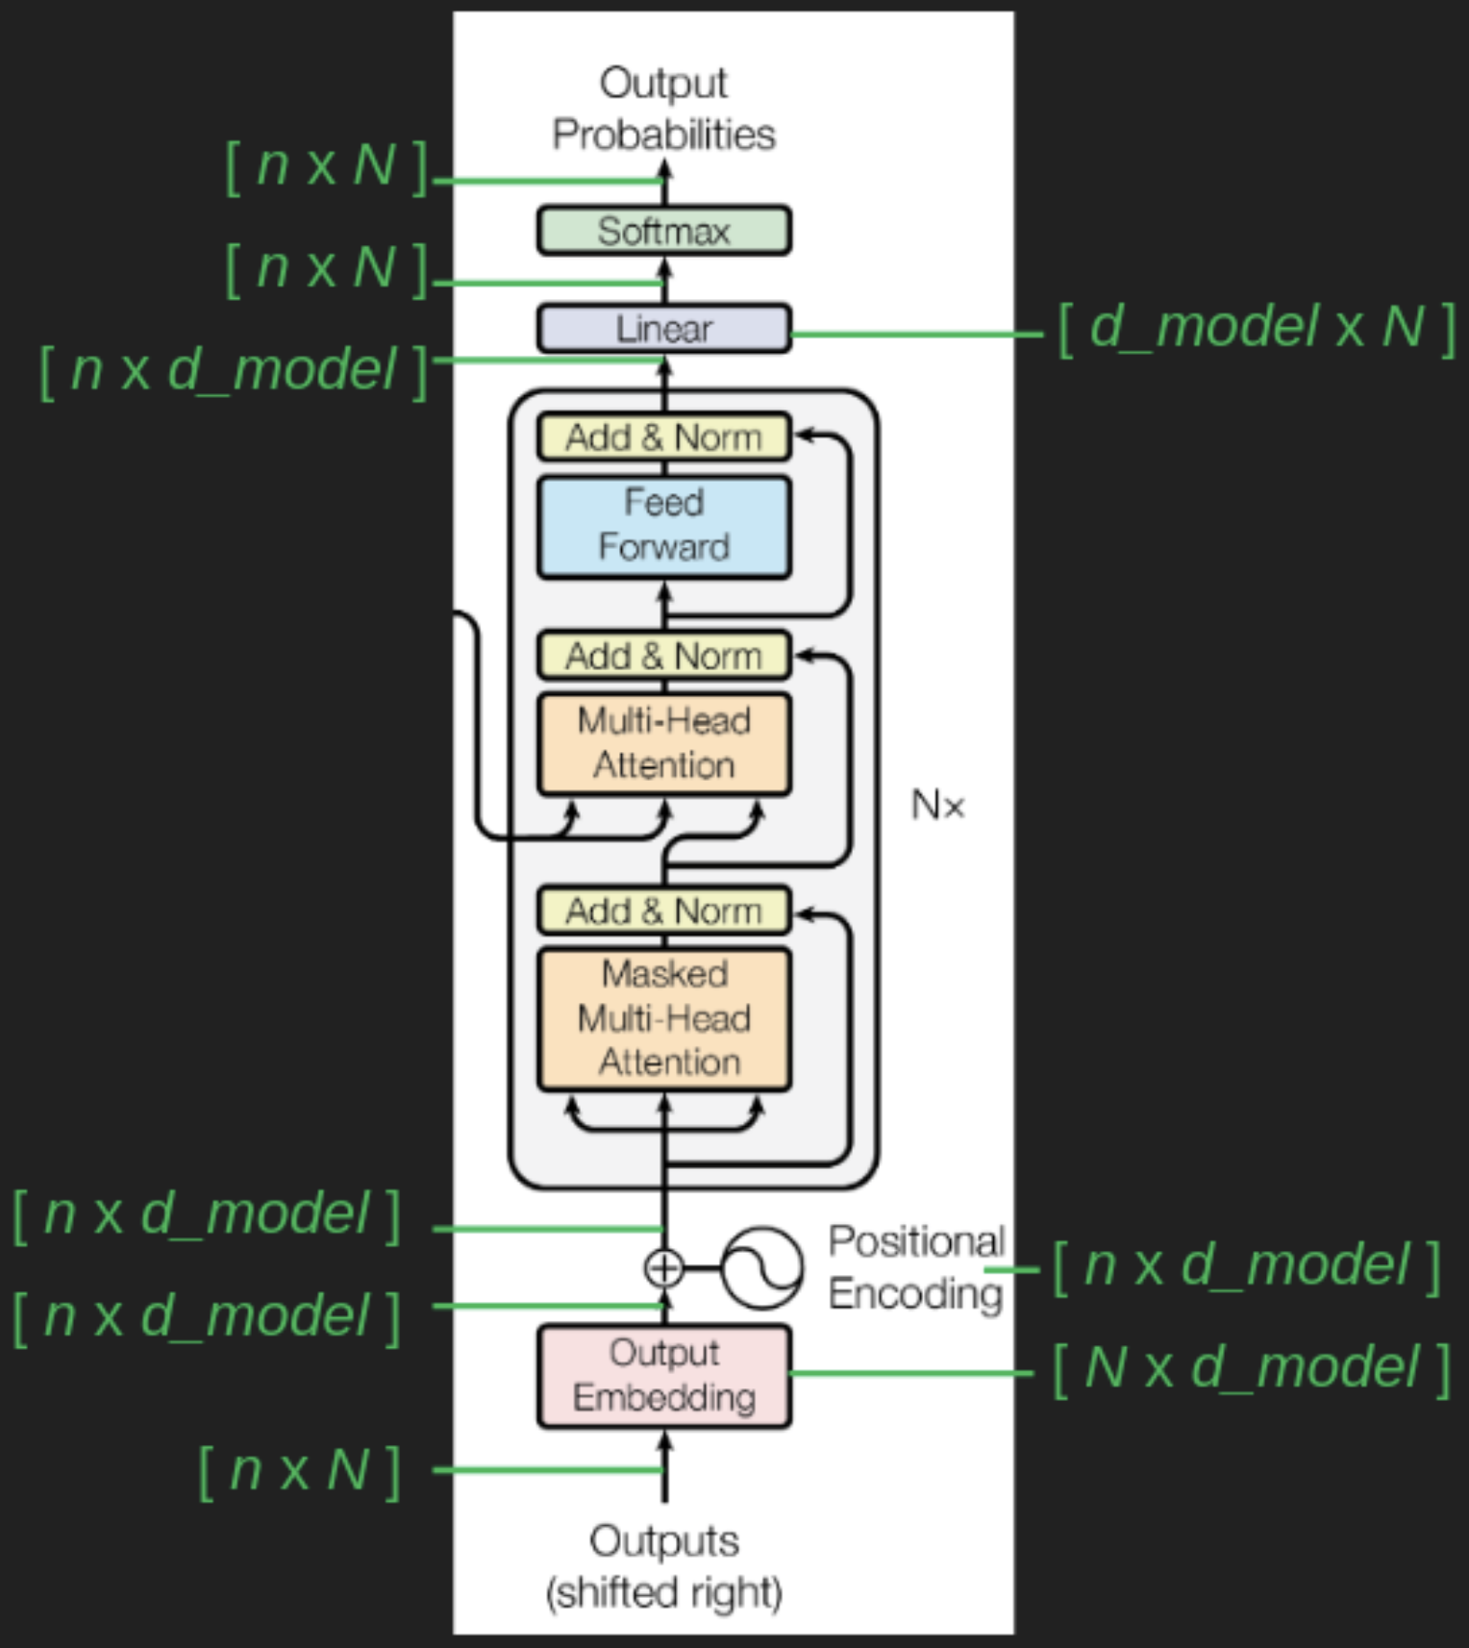
De-Embedding and Softmax
conversion of final decoder output to predicted next-token probabilities for output vocabulary
de-embedding: linear transformation (fully-connected network layer) to vocabulary size
softmax: transformation to probabilities (“softness” can be controlled by hyperparameter → temperature)
n: sequence length
N: vocabulary size
d_model: embedding dimensions
source

Slide 23
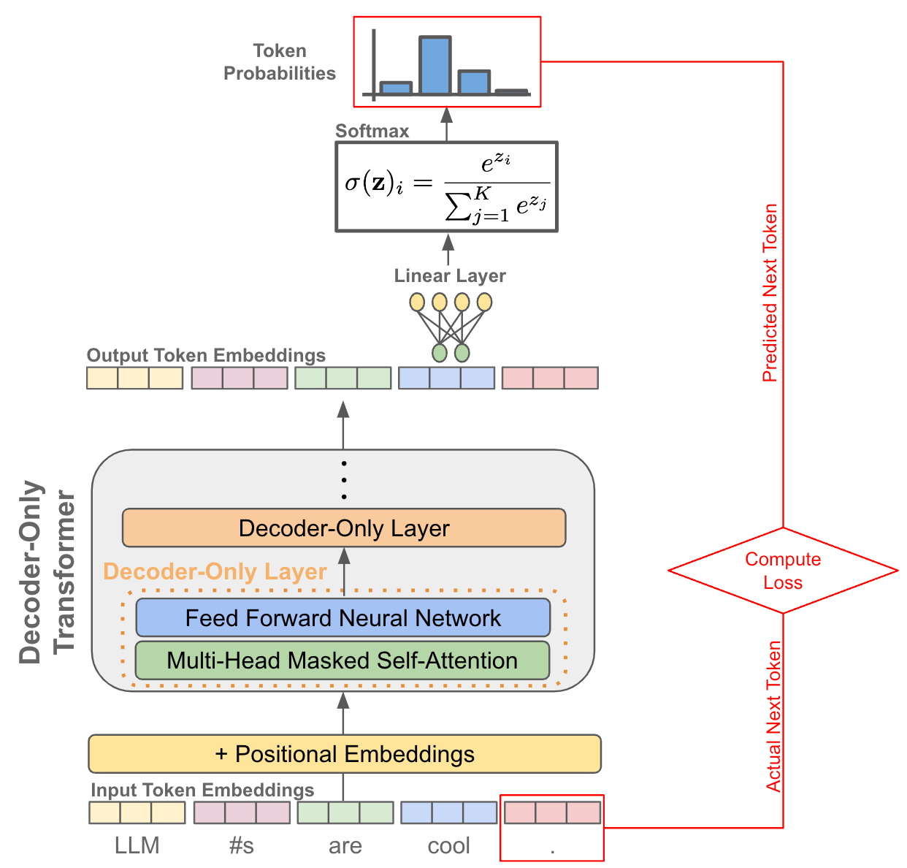
source

Slide 24
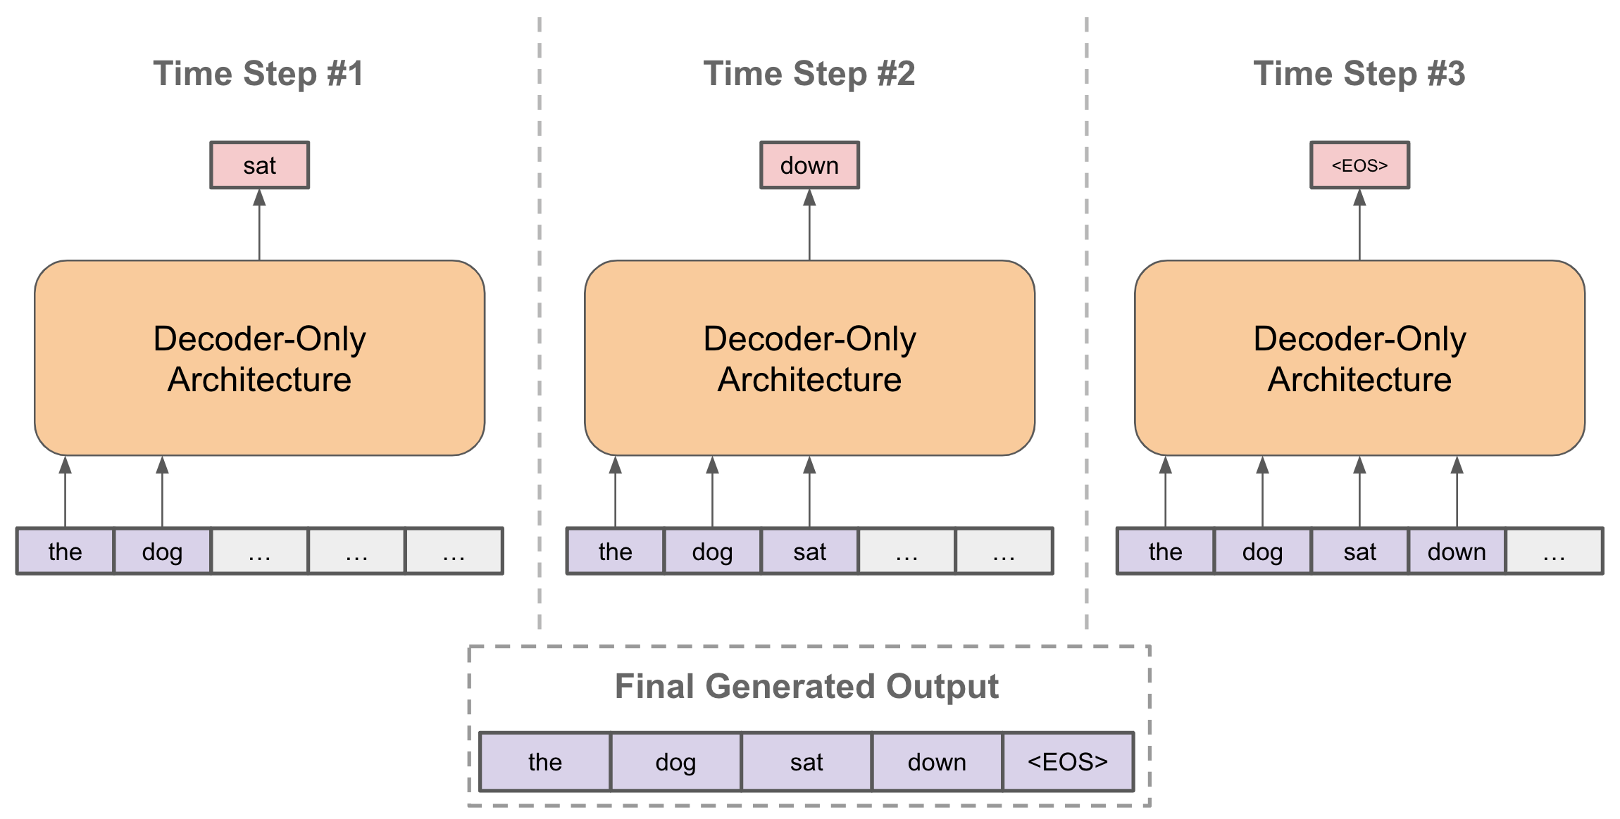
Sequence Completion
autoregressive: for each step (iteratively), choose one output token and then add it to decoder input sequence for next step
typically, pick according to softmax probabilities (degree of randomness controlled by softmax temperature)
source
prompt: externally given initial sequence for running start and context on which to build rest of sequence

Slide 25
Sampling Strategies

